Slide 1
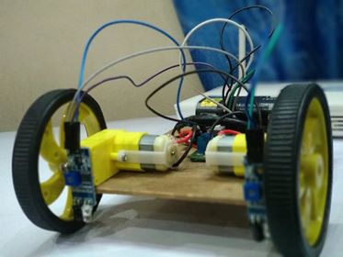
Line Following Robot
By Susan ghimre

Slide 2
Introduction
Line following Robot is a simple wheel supported Robot which follows the line drawn on the surface on which it moves. It tracks the line with the help of infrared sensors (IR) and move according to the data provided by the sensors.

Slide 3
Why I choose this project?
Simple to construct for beginners.
Helps in understanding the use of motors, motor drivers and IR sensors.
Portable and easy to demonstrate.
Various uses in higher version.

Slide 4
construction
This robot is constructed using:
IR sensors(2)
Motors(2)
Motor drivers(1)
Battery(1)
Support body and wheels(2)
Switch and connecting wires

Slide 5
Working:
For the proper working of the Robot the battery provides the power to IR and to the motor driver. IR sensors are connected to the motor drivers and the motor drivers to the motors. The Robot is placed in a surface with a white line. When the sensors face the black surface they observe IR radiation and hence the collector can’t sense the Radiation and returns signal to the motor driver and the driver rotates the motor. When the sensor faces the white surface then it returns the signal and the motor driver stops the respective motor. This cause one motor to rotate but other to stop hence the Robot begins to turn in a direction following the line.

Slide 6
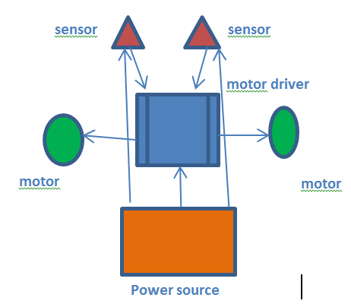
Simple representation of the system:

Slide 7
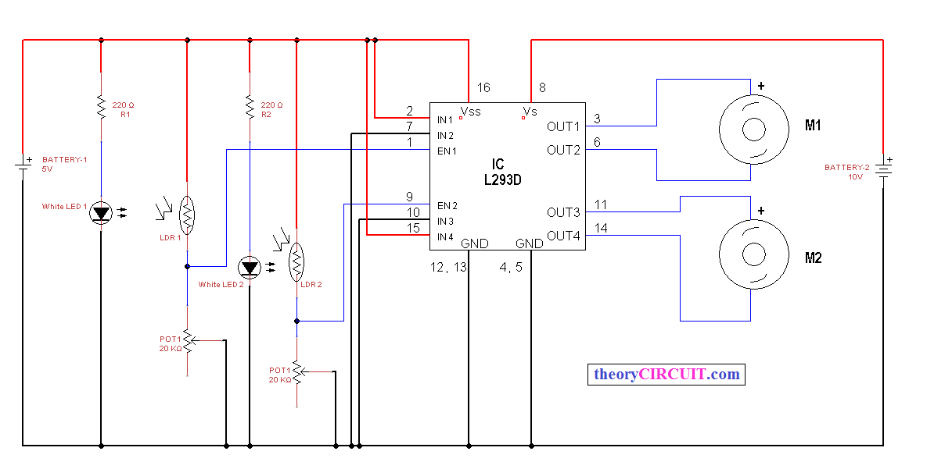
Schematic drawing

Slide 8
Application and Future Enhancement
It can be used to make day to day transportation system.
Moving materials inside a house or industries will be quite much easier with the help of this robot.
As it moves in a fixed path it can be used to do repetitive work in a certain area.
In future it can be used to make a fully automated home system where all the transportation works are done by robots.
It can be used to transport material from mine which will save a lot of cost and manpower.

Slide 9
Thank you

